Slide 1

NoSql/Mongo Db
Lecturer
Rokas Slaboševičius
Data

Slide 2
What is a NoSql database?
NoSql/Mongo Db
No relational (sometimes not only relational) document management system (DMS);
Such a DB does not require the creation of fixed and pre-described schemas (tables with a rigid structure), avoids table joins and is easy to extend;
Used where very large amounts of data storage are required (Big Data concept);

Slide 3
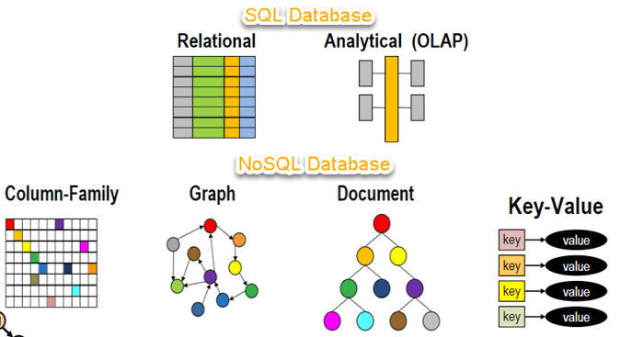
What is a NoSql database?
NoSql/Mongo Db

Slide 4
What is a NoSql database?
NoSql/Mongo Db
Not relational:
does not use a relational model;
does not have tables with pre-fixed columns;
working with individual data types or BLOBs;
does not require ORM and data normalisation;
no complex functions like queries or relational joins (joins);

Slide 5
What is a NoSql database?
NoSql/Mongo Db
Schema-free:
does not use schemas, or if it does, the schemas are less stringent than RDBMS;
does not require a prior description of database schemas;
allows different data to be stored in the same "place";

Slide 6
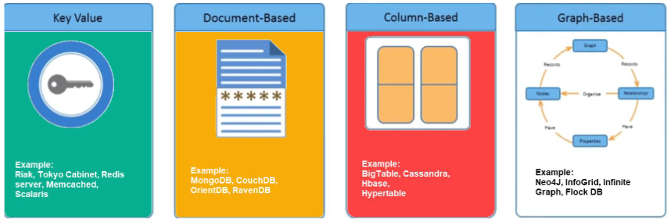
NoSQL DB types
NoSql/Mongo Db

Slide 7
NoSQL DB types
NoSql/Mongo Db
There are 4 types of NoSQL databases:
Key-Value pairs of type DB;
Document-oriented DB;
Column-oriented DB;
Graph-oriented DB

Slide 8
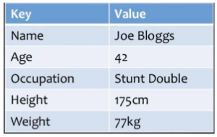
Key-Value pair type DB
NoSql/Mongo Db
Data is stored in pairs (key-value). Easily handles large amounts of data and high DB loads. As you know, data storage is done using a hash table in which the DB key (key) must always be unique and the value (value) can be JSON, BLOB, string, etc.This type of DB is used for e.g. shopping carts (Amazon Dynamo)

Slide 9
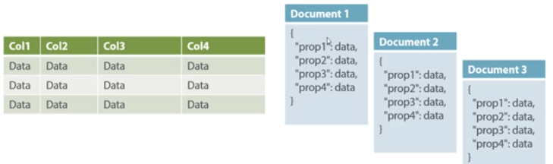
Document-oriented DB
NoSql/Mongo Db
Data is also stored in pairs (key-value), but the value part is a document. The document itself is stored in JSON or XML format.

Slide 10
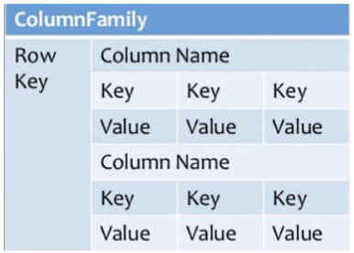
Columnarly oriented DB
NoSql/Mongo Db
Google BigTable is the basis for the creation of DBs that store data in columns instead of rows.The reason for the creation of such DBs is the high performance when working with aggregation functions such as SUM, COUNT, AVG, MIN...

Slide 11
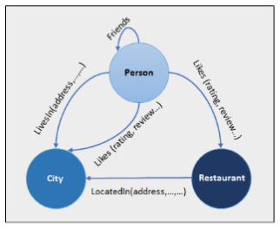
Graph-oriented DB
NoSql/Mongo Db
Such DBs store data as entities and relationships between entities. Entities are stored in the vertices of the graph, and the edges that connect the vertices specify the relationships between the vertices.Unlike relational DBs, where the tables are not necessarily connected by relationships, graph-oriented DBs are strictly relational (multi-relational) by nature.

Slide 12
Benefits of NoSQL
NoSql/Mongo Db
Big Data compatibility;
Easy replication;
High productivity and horizontal expansion;
Object-oriented programming;
NoSQL does not require a powerful server;
Supports major programming languages and platforms;
Allows you to change the DB structure without downtime;

Slide 13
Benefits of NoSQL
NoSql/Mongo Db
There are no standardised rules;
Limited query possibilities;
Relational DBs and their tools are significantly more sophisticated;
As the amount of data increases, it becomes difficult to find a unique key;

Slide 14
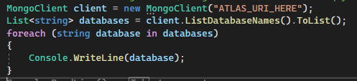
Using MongoDB with C#
NoSql/Mongo Db
Install the MongoDb package 'Install-Package MongoDB.Driver -Version 2.14.1'
'dotnet add package MongoDB.Driver' for mac users
The source code will look like this:

Slide 15
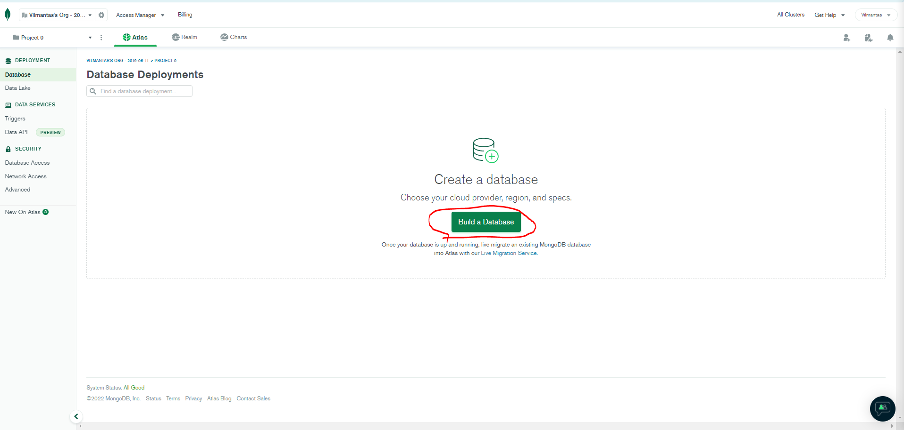
Creating a Mongo DB
NoSql/Mongo Db
Register here: https://cloud.mongodb.com/
Click on Build a Database

Slide 16
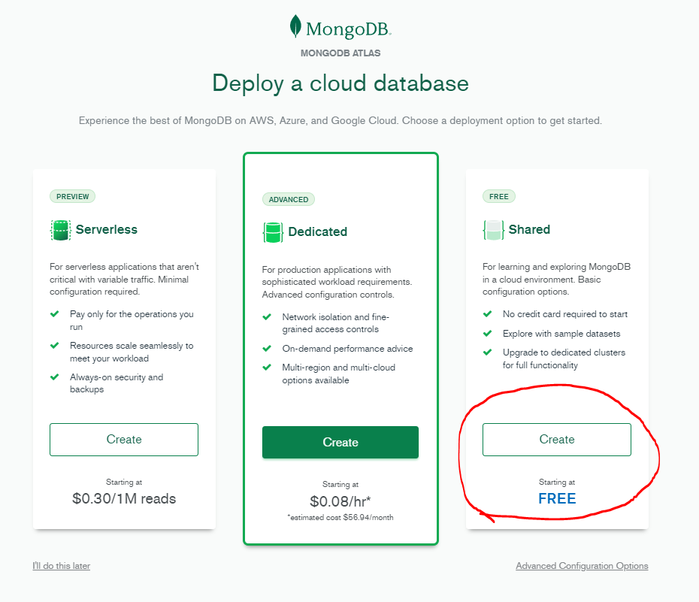
Creating a Mongo DB
NoSql/Mongo Db

Slide 17
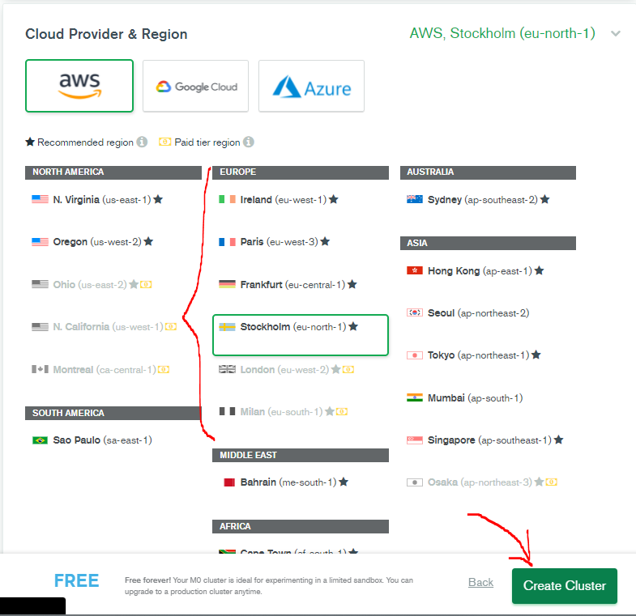
Creating a Mongo DB
NoSql/Mongo Db
Choose one of the European servers
and click Create Cluster

Slide 18
Creating a Mongo DB
NoSql/Mongo Db
Choose one of the European servers
and click Create Cluster

Slide 19
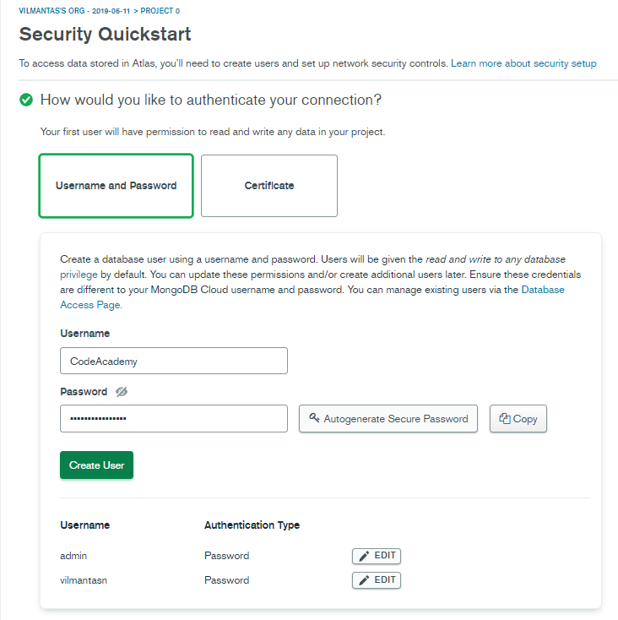
Creating a Mongo DB
NoSql/Mongo Db
Enter the Username of the new user
Generate a password
Copy it (we'll use it soon so you can save it)
Click "Create user"

Slide 20
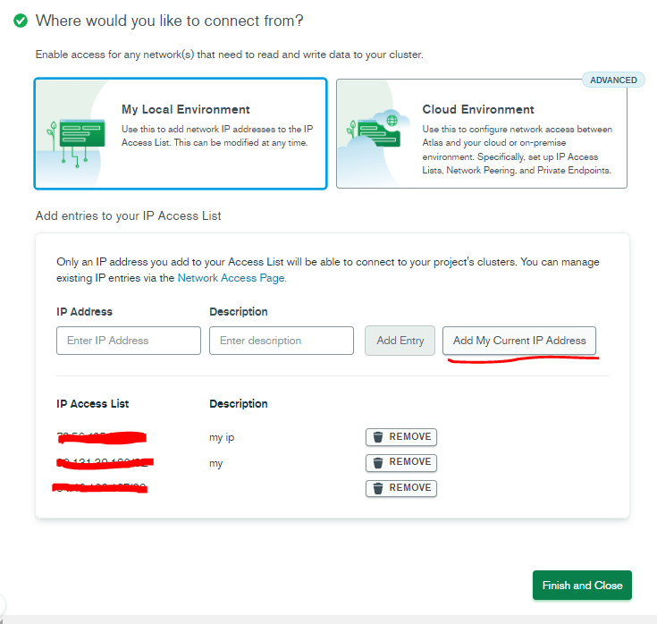
Creating a Mongo DB
NoSql/Mongo Db
Add the existing IP address and click
Finish and Close

Slide 21
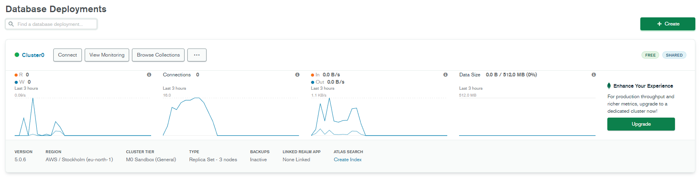
Creating a Mongo DB
NoSql/Mongo Db
Here we see our database named "Cluster0"
Click "Connect"

Slide 22
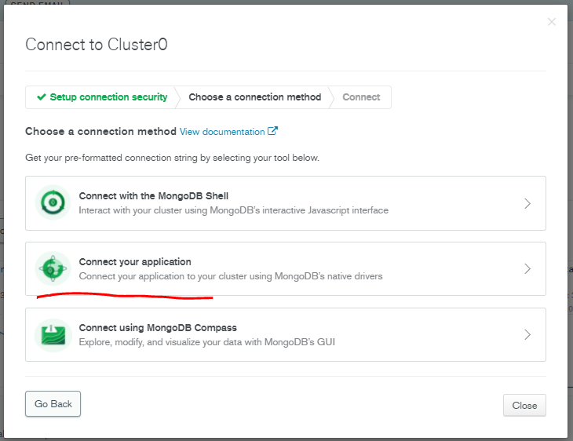
Creating a Mongo DB
NoSql/Mongo Db

Slide 23
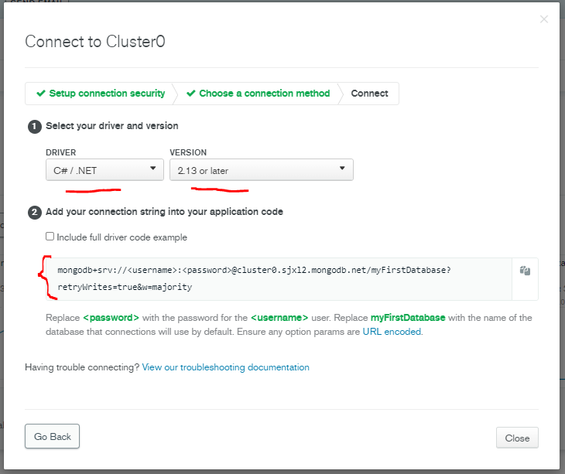
Creating a Mongo DB
NoSql/Mongo Db
Choose as in the photo
Copy the Connection string and replace <username>
and <password> in the credentials of the user you created

Slide 24
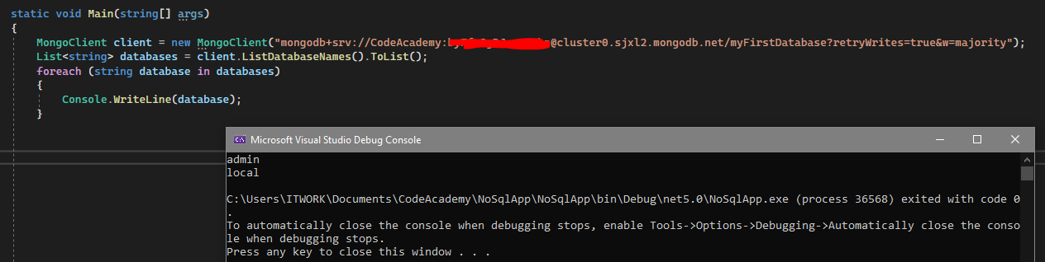
Creating a Mongo DB
NoSql/Mongo Db
Start the app

Slide 25
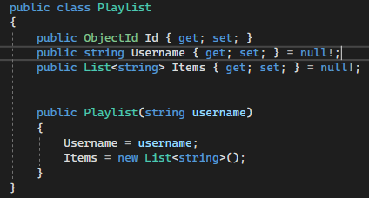
Using Mongo DB
NoSql/Mongo Db
We create a model

Slide 26
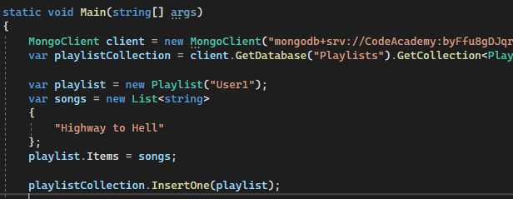
Using Mongo DB
NoSql/Mongo Db
We insert the model

Slide 27
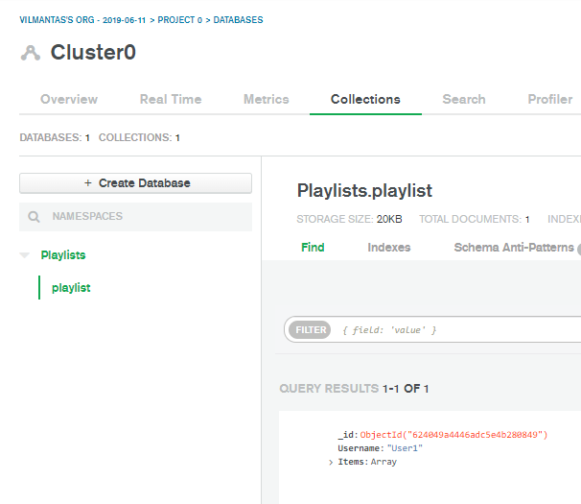
Using Mongo DB
NoSql/Mongo Db
Check the database entry

Slide 28
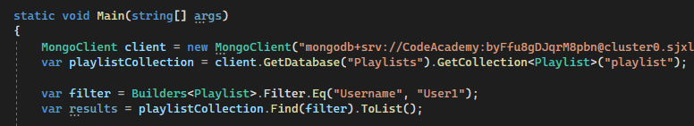
Mongo DB usage(get)
NoSql/Mongo Db
We create a filter that will use the "Username" fields to look for the value "User1".
When it finds our value, it will return the entire document in which it found the value.

Slide 29
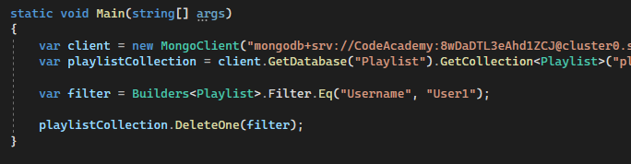
Using Mongo DB(delete)
NoSql/Mongo Db
To delete an entry, we can use the same filter by selecting DeleteOne from playlistCollection
delete the first record found that meets the condition

Slide 30
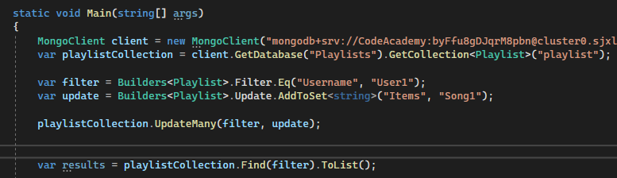
Using Mongo DB(update)
NoSql/Mongo Db
To update the data, we need to create an Update Builder and specify what update we will do
In this case, it will be a case of adding a new member to the Items column with the value "Song1".
Then we call the UpdateMany method using the same filter as before and the newly created update.

Slide 31

NoSql/Mongo Db
Task 1
Create a new project
Create a Book model with Id, Name and Pages, which will be a Page class with Id and Content properties
Create a repository Book repository, through which the programme:
Add new book entries
Delete
Update
Search

Slide 32
Lecture title
Headline
www.youtube.com
Useful information

